Slide 1
A Simple Introduction to Scrum Master Certified(SMC)

Slide 2
Scrum Artifacts
1. Product Backlog.
2. Monitoring Progress Toward Goals
3. Sprint Backlog.
4. Monitoring Sprint Progress
5 .Increments.
6. Definition of Done.

Slide 3
Product Backlog(Part 1)
The PO is responsible for the product backlog.
Ordered list of everything needed in the final product of the project.
All items are described in simple business language and all of them are presentable to each stakeholder.
The Product Backlog is dynamically changing and improving; it is never complete.
We do not wait until the Product Backlog is complete to start delivering the items;
the first Sprint can be started as soon as the Product Backlog is showing the near future.
The Product Owner sets a number of factors to determine the value of each item for the business; return on investment is usually one of the factors.
Higher the item the sooner it will be delivered by the Scrum team.

Slide 4
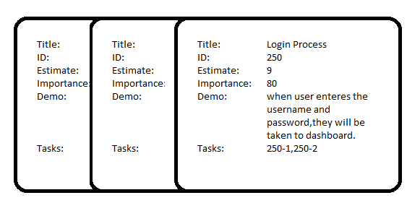
Product Backlog(Part 2)
The SM has responsibilities to help PO groom and maintain the product backlog.
Product backlog is an ordered list of items(stories).
Each product backlog item also has work estimate.

Slide 5
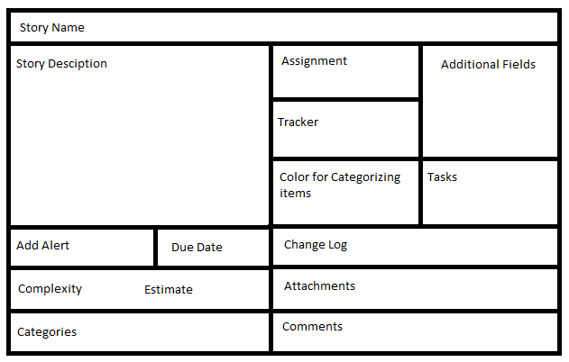
Product Backlog(Part 3) Product Backlog Item

Slide 6
2. Monitoring Progress Toward Goals(Part 1)
At any time work remaining could be summarized.
PO tracks work at every sprint review.
PO compares work remaining in previous sprint to access progress towards the goal.
This information is made available to all stakeholders.
Empirical processes are used in situations where it is difficult to have consistent processes.

Slide 7
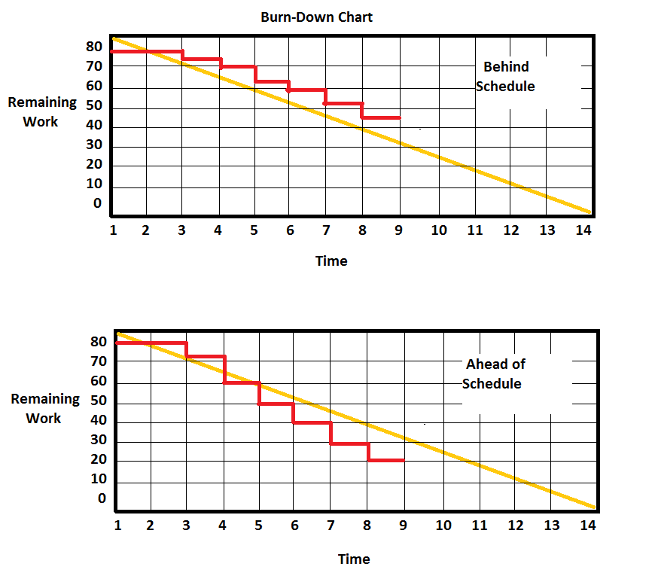
2. Monitoring Progress Toward Goals(Part 2)

Slide 8
Sprint Backlog(Part 1)
The Sprint Backlog is created during the Sprint Planning event.
During the Sprint Planning event, the Scrum Team collaborates on creating the Sprint Backlog, which consists of the following:
  A number of items selected from the top of the Product Backlog, based on their estimated work and the estimated capacity of the Scrum Team.
  The Sprint Goal, which will help describe the real meaning of the items and direct the efforts of the Scrum Team.
  A detailed plan for delivery of the items and realization of the Sprint Goal during the Sprint.

Slide 9
Sprint Backlog(Part 2)
The Sprint Backlog is frozen after the Sprint Planning.
The statement “the Sprint Backlog is frozen” means that items (stories) in the Sprint Backlog cannot be added or removed during the Sprint.
However, it might be necessary to re-negotiate, justify, or clear some of the items during the Sprint, which should be done in the presence of the Product Owner.
The detailed plan which is normally not complete at the end of the Sprint Planning will become more complete as the Sprint continues.

Slide 10
Monitoring Sprint Progress (Part 1)
Besides the monitoring done for the whole project, we should also monitor the progress of each single Sprint throughout its life.
This is the responsibility of the Scrum Team and should be done at least once per Daily Scrum.
This information is used to calculate the likelihood of achieving the Sprint Goal and completing all items of the Sprint Backlog.

Slide 11
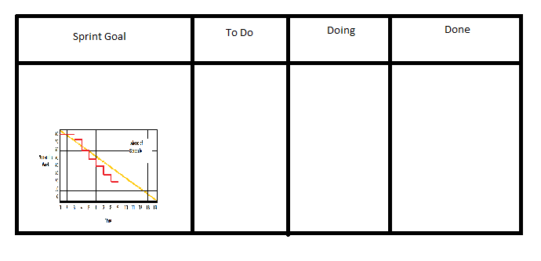
Monitoring Sprint Progress (Part 2)
The Sprint progress information can be represented by a burn-down chart, and this chart can be a part of the Sprint board, where everyone can see.

Slide 12
Increment(Part 1)
The Increment is the total of all the Product Backlog items at the end of sprint.
At the end of a Sprint, the new Increment must be “Done,” which means it must be in useable condition and meet the Scrum Team’s definition of “Done.”
The increment is a step toward a project vision.
The increment must be in useable condition regardless of whether the Product Owner decides to release it.

Slide 13
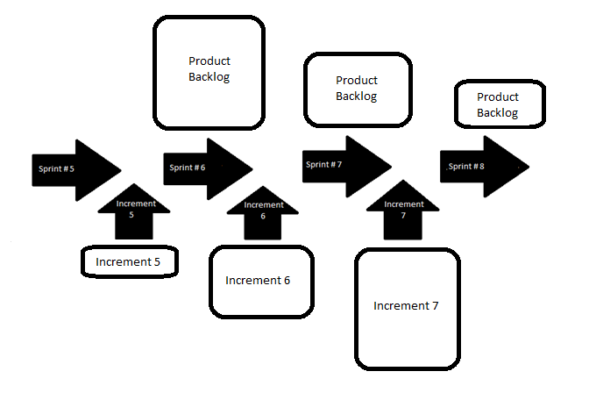
Increment(Part 2)

Slide 14
Definition of Done.
When a Product Backlog item or an Increment is described as “Done”, everyone must understand what “Done” means.
A shared understanding of what it means for work to be complete, to ensure transparency.
The definition of “Done” is used to assess when work is complete on the product Increment.
It guides the Scrum Team in knowing how many Product Backlog items it can select during a Sprint Planning.
The purpose of each Sprint is to deliver Increments of potentially releasable functionality that adhere to the Scrum Team’s current definition of “Done.”

